Slide 1
University of Basrah
College of Nursing
Fundamentals of Nursing Department
Second stage Adult Nursing (1)
Practical- Review of system
2- Cardiovascular System (CVS)
BY
Assist Lectu. Ali Malik Tiryag, Msc, Adult nursing
Assist Lectu. Saja Kareem Jassim, Msc, Adult nursing

Slide 2
QUIZ/ Case study
68 years old age male, obese. admitted to CCU with severe sharp chest pain, vomiting, and diaphoresis. The pain is so sharp no longer than 5 hours. Not response to the sublingual GTN.
1- How can you write Chief compliant?
2- What is other question you should asked to the patient to expect the diagnosis.

Slide 3
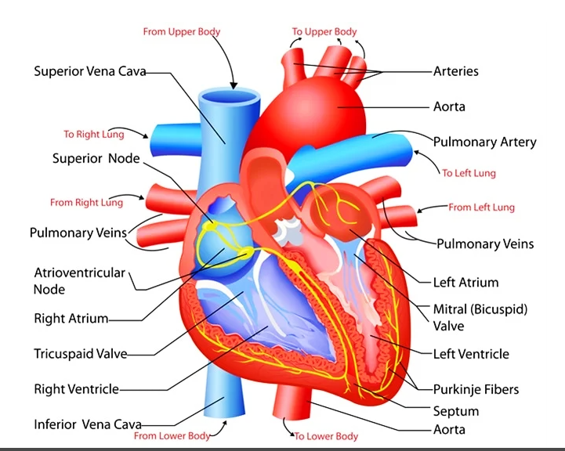

Slide 4
Cardiovascular System Assessment
1- Chest Pain.
Causes of Chest Pain:
1- Respiratory (pneumonia, tuberculosis, pleurisy).
2- Cardiac (angina, myocardial infarction).
3- Gastrointestinal (esophagitis).
4- Musculoskeletal (Trauma, rib fracture).
5- Anxiety.
Chest pain related to CVS is caused by:
1- Angina.
2- Myocardial Infarction.
3- Pulmonary embolism.
4- Pericarditis.

Slide 5
Items | Angina | Myocardial Infarction
1- Location | Substernal | Across chest
2- Onset | Gradual | Sudden
3- Radiation | Not radiated | Radiated to the shoulder, neck, jaw, and back
4- Duration | 5-15 minute | > 15 minute
5- Character | Aching, burning, squeezing | Tightness, Pressure
6- Aggravating factors | Heavy meals, stress, cold weather, activity | At rest
7- Relieving factors | Angesid (GTN), rest | Opioid analgesic (morphine)
8- Associated Symptoms | No vomiting | Diaphoresis, nausea, vomiting

Slide 6
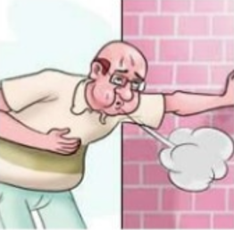
2- Dyspnea: breathlessness, shortness of breath (SOB), and difficulty breathing.
Causes of dyspnea related to CVS
1- Acute coronary syndrome.
2- Valvular heart disease.
3- Orthopnea: Shortness of breath that occurs during lying flat position caused by:
1- Heart Failure.
2- Left ventricular hypertrophy.
4- Paroxysmal Nocturnal Dyspnea: Shortness of breath that occurs at night. That cause wakes up the patient. The most common cause is heart failure. Relieved by upright position.

Slide 7
Common questions asked to patients with SOB:
1- Position (upright, standing, sitting).
2- Onset.
3- Duration.
4- Occur at rest or exertion.
5- Severity (by asking about the distance that the patient can be walking).
6- Any increase and decrease factors.
7- Associated symptoms.
8- Number of pillows(patient with orthopnea).
9- Timing (at night, day).

Slide 8
5- Palpitation: Awareness of heartbeats.
Causes of palpitation:
1- Cardiac causes (arrhythmia, hypertension, and mitral stenosis).
2- Non-cardiac causes include:
A- Asthma and emphysema.
B- Blood loss.
C- Anxiety and stress.
D- Drugs (digoxin, antidepressant), caffeine, tobacco.

Slide 9
Common questions asked to patients with palpitation:
1- Onset: when they started (rest, exercise), sudden or gradual, previous episodes.
2- Timing: continuous/intermittent, frequency and duration (seconds/hours), time of day (the night when quiet).
3- Character: fast/slow.
4- Associated symptoms: chest pain, faintness, syncope/loss of consciousness, and breathlessness.

Slide 10
6- Syncope: Brief loss of consciousness.
Causes of syncope
1- Cardiovascular cause (pulmonary embolism).
2- Neutrally mediated.
3- Orthostatic hypotension.
7- Claudication: Impairment in walking or pain (discomfort) in the legs that occur during walking due to decrease blood flow to the legs and is relieved by rest.

Slide 11
Types of Claudication
1- Intermittent Vesicular Claudication. Cramping pain, especially in the calf muscle.
2- Spinal or Neurologic Claudication.
3- Jaw Claudication.
Causes of Intermittent Claudication:
1- Cardiovascular cause (acute arterial occlusion).
2- Hypertension.
3- Hyperlipidemia.
4- Diabetes Mellitus.

Slide 12
During exercise, when your muscles need more blood, intermittent claudication can cause problems including:
Cramping
Numbness
Pain
Tingling
Weakness
You usually feel these symptoms in your legs, from your feet up to your buttocks. It gets better or goes away when you stop moving.

Slide 13
Common Questions asked to patient about claudication.
Character
when did the pain start
increasing and decreasing factors
Distance that the patient can walk before pain start.

Slide 14
8- Edema:
Is swelling of soft tissue due to increased interstitial fluid.
Causes of edema:
1- Cardiovascular causes
Heart failure
Venous stasis
Constrictive pericarditis
2- Other causes
Nephrotic syndrome
Liver disease
Drugs (Steroid)

Slide 15
8- Edema:
Etiology of Edema
1- Generalized edema is most commonly caused by
Heart failure
Liver failure
Kidney disorders (especially nephrotic syndrome)
2- Localized edema is most commonly caused by
DVT or another venous disorder or venous obstruction (eg, by tumor)
Infection
Lymphatic obstruction
Chronic venous insufficiency may involve one or both legs.

Slide 16
Question about Edema
History of present illness should include:
1- location and duration.
2- presence and degree of pain or discomfort.
3- Female patients should be asked :
whether they are pregnant? and whether edema seems related to menstrual periods.
4- Having patients with chronic edema keep a log of weight gain or loss is valuable.
5- Disorders known to cause edema, including heart, liver, and kidney disorders and cancer (including any related surgery or radiation therapy).
6- Drug history should include specific questions about drugs known to cause edema. Patients are asked about the amount of sodium used in cooking and at the table.

Slide 19
NURSING DIAGNOSIS
Fluid Volume Deficit Related Factors 1- Inadequate fluid intake 2- Active fluid loss (diuresis, abnormal drainage or bleeding, diarrhea) 3- Fluid shifts (edema or effusions) Manifested by:
1-Decreased urine output 2-Output greater than intake 3-Decreased venous filling 4-Hypotension 5-Decreased skin turgor

Slide 20
Actions/Interventions/
(i) independent (c) collaborative (i) Monitor and document vital signs. (i) Assess skin turgor and mucous membranes for signs of dehydration. (i) Assess color and amount of urine. Concentrated urine denotes fluid deficit. (i) Document baseline mental status and record during each nursing shift. (i) During treatment, monitor closely for signs of circulatory overload (headache, flushed skin, tachycardia, venous distention, elevated central venous pressure [CVP], shortness of breath, increased BP, tachypnea, cough)

Slide 21
Therapeutic Interventions
(c) Encourage patient to drink prescribed fluid amounts. (i) Assist patient if unable to feed self and encourage caregiver to assist with feedings as appropriate. (i)Plan daily activities for more severe hypovolemia: (c) Obtain and maintain a large-bore intravenous (IV) catheter. Parenteral fluid replacement is indicated to prevent shock

Slide 22
2- Fluid Volume Excess Related Factors 1-Excessive fluid intake 2-Excessive sodium intake 3-Steroid therapy Manifested by: 1-Weight gain 2-Edema 3-Abnormal breath sounds: crackles 4-Change in respiratory pattern

Slide 23
Therapeutic Interventions
Actions/Interventions/Rationale (c) Institute/instruct patient regarding fluid restrictions as appropriate. (c) Restrict sodium intake as prescribed. (c) Administer or instruct patient to take diuretics as prescribed. (i) Instruct patient to avoid medications that may cause fluid retention, certain vasodilators, and steroids. (I) elevate edematous extremities. (i) Reduce constriction of vessels (use appropriate garments, avoid crossing of legs or ankles). To prevent venous pooling. (c) Instruct in need for ant embolic stockings or bandages as ordered. ##To help promote venous return and to minimize fluid accumulation in the extremities. (i) Apply heparin lock on IV line. ##To maintain patency but to decrease fluid delivered to patient in a 24-hour period. (c) Administer IV fluids through infusion pump. (i) Provide adequate activity or position changes as able. ##To prevent fluid accumulation in dependent areas.

Slide 24
Actions/Interventions
(i) Assess or instruct patient to monitor weight daily and consistently (i) Monitor and document vital signs. (i) Monitor for distended neck veins and ascites (i) Assess for crackles in lungs, changes in respiratory pattern, shortness of breath, and orthopnea. (i) Assess for presence of edema by palpating over, ankles, feet, and (c) monitor hemodynamic status including CVP, PAP if available. This direct measurement serves as optimal guide for therapy.

